Slide 2
ENGAGE YOUR CITY
CASSIE HAMMETT

Slide 3
THE GOSPEL CHANGES LIVES, FAMILIES & COMMUNITIES

Slide 4
Let’s lay some groundwork… Your church is called to expand the Kingdom of God in your city. When the Kingdom of God expands, your city, as a result, becomes a better-more just place to live.

Slide 5
The people in your church are called to live the life of a Jesus follower. Jesus transforms sinful people into people who see the world through His eyes. Jesus transforms us into JUST people. Justice isn’t something to “DO”, it is a way to BE.

Slide 6
Engaging your city will always involve your city’s greatest needs. Engaging your city will always include the vulnerable, the poor and the injustices that exist.

Slide 7
WHAT IS JUSTICE & WHAT IS THE CHURCH’S ROLE IN IT? HOW DO WE PRACTICALLY DO THIS?

Slide 8
REFRAMING JUSTICE:
All humans are created in the image of God and are equal before God, therefore have the right to be treated with dignity and fairness, no matter who you are.
God’s people are called to do “righteousness & justice”.
Righteousness (tzedek)- ethical standard that refers to right relationships between people; it’s about treating others as the image of God.
Justice (mishpat)- restorative; seeking out vulnerable people who are being taken advantage of and caring for them. It means taking steps to advocate for the vulnerable and changing social structures to prevent injustice.

Slide 9
MERCY VS. JUSTICE
When we respond to the immediate needs of the poor, we are choosing to be merciful. That is good, but that is not necessarily justice. Justice is not a response to a problem, mercy is. Justice looks beyond the problem to see how people ended up in that broken place and works to overcome barriers so they can be restored.”
― Michelle Ferrigno Warren, The Power of Proximity: Moving Beyond Awareness to Action

Slide 10
REFRAMING JUSTICE:
God is the God of justice.
He has a standard of absolute justice for all things.
We are called to be like His son in the way that we live.
We are called to carry the Gospel to the world around us.
There is only one way to God: through Jesus. However, there are a million ways to J
Social justice is not the Gospel, but is a vehicle for the gospel to be carried to the most vulnerable.
Without living justly in the world, whole populations would never have access to the Gospel nor discipleship.

Slide 11
Justice & The Church
“The local New Testament church is THE tool ordained by God for the expansion of His Kingdom in cities and nations.” Vance Pitman
The church is God’s Kingdom come to earth; the physical showing up of God’s invisible nature. When God’s Kingdom comes, when it expands, justice for people comes.
The role of the church in justice is not just to “do” justice, but to become just as a body, and as a result to physically be a part of bringing justice to the lives of the people in our city.

Slide 12
How it typically works…

Slide 13
“Framing justice as outreach is practically problematic. In our normal ways of thinking about church ministry, we invite people to participate in outreach based on their personal preferences and passions. There is something for everyone and everyone gets to choose the outlet that suits them. When we frame justice as one of the options on the outreach menu of church life, church members sign up for opportunities to “do justice” by checking that box in the bulletin. If justice is an option on the outreach menu, that means justice is optional for everyone.” - Becoming a Just Church

Slide 14
MOVING YOUR CHURCH TO ENGAGE the POOR IN YOUR CITY

Slide 15
THEOLOGY AROUND IT. PATHWAY TO IT. CORPORATE PRACTICE OF IT.

Slide 16
THEOLOGY AROUND IT.
What does the Bible say about justice?
What does the Bible say about the church’s role?
What do we believe about the Gospel and the poor?
What are we called to?
PATHWAY TO IT.
CORPORATE PRACTICE OF IT.

Slide 17
THEOLOGY AROUND IT.
Assess Your City
Assess Yourself
Friendship
Learning
PATHWAY TO IT.
CORPORATE PRACTICE OF IT.

Slide 18
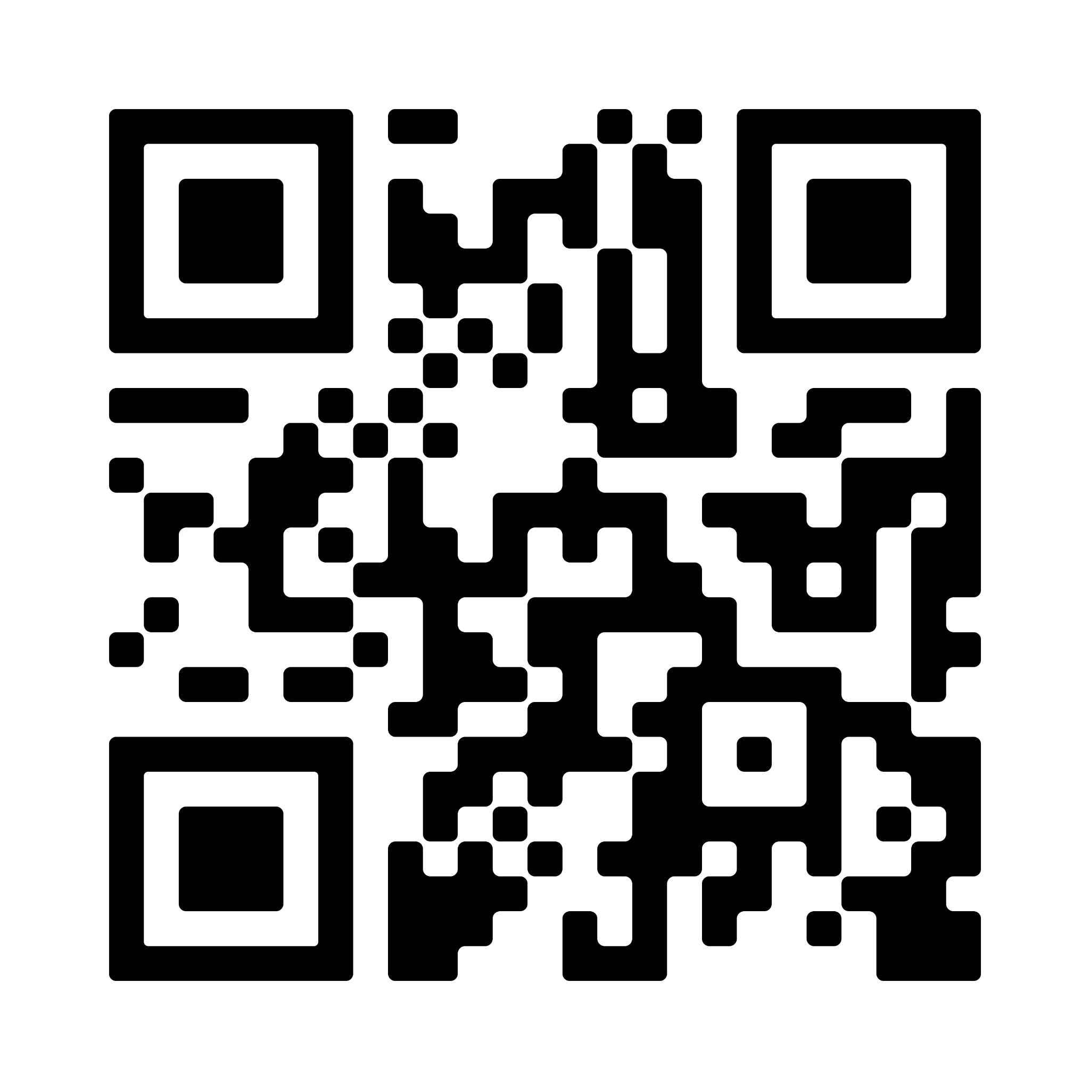
SCAN FOR CITY ASSESSMENT!

Slide 19
THEOLOGY AROUND IT.
Build opportunities for justice into the rhythms of your church.
Practice engaging your city often.
Leaders go first.
PATHWAY TO IT.
CORPORATE PRACTICE OF IT.

Slide 20
SEND RELIEF IS HERE FOR YOU!

Slide 23
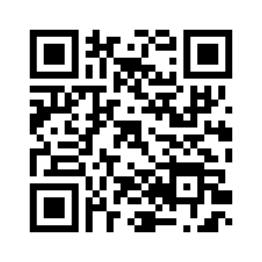

Slide 24
