Slide 1
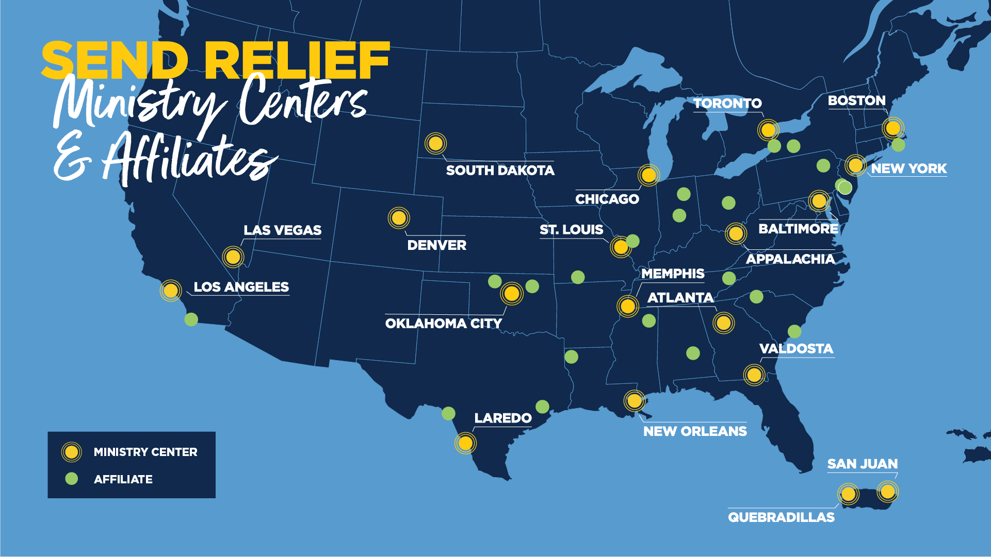
Need updated MC and affiliate map

Slide 2
